Slide 1
Case study 1
Diabetes management and AI insulin delivery system

Slide 2

Date formatting
original_sgv.csv
original_treatments_mongoDB.csv
EEE MMM dd HH:mm:ss zzzZ yyyy
Scientific notation (exponential format)
M/D/YYYY H:mm:ss

Slide 3
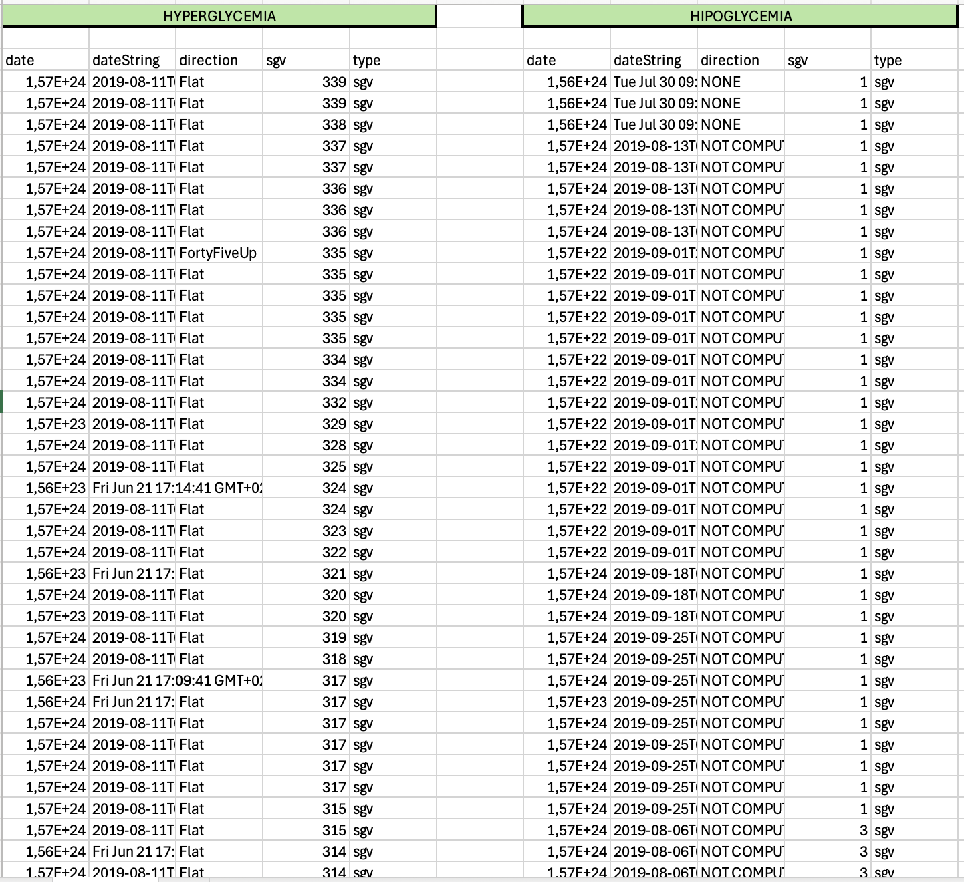
Wrong values in glycemia
Hypoglycemia:
sgv < 20 (only values 1,3,5)
Hyperglycemia:
sgv > 400

Slide 4
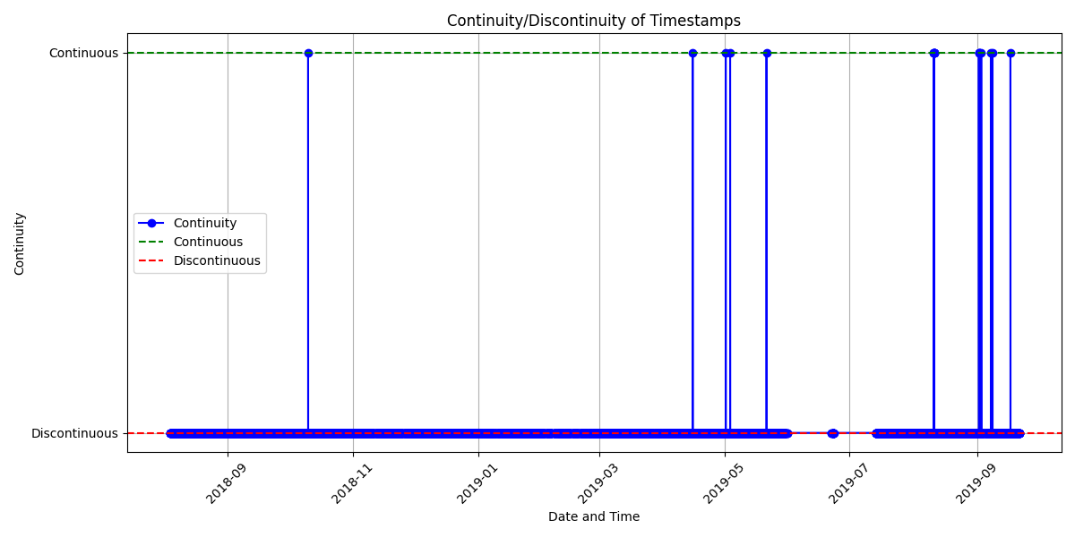
Dis/continuity of data information
It is updated each 5 minutes approximately.
We can see that there are some large gaps that exist.

Slide 5
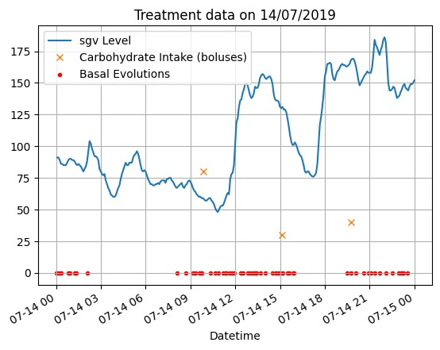
Graph on 14/07/2019
Approximately after 30 minutes of ingesting carbs,
we will see a raise of the blood sugar
Similarly, after the same amount of time of ingesting the insulin, we can see a drop

